Slide 1
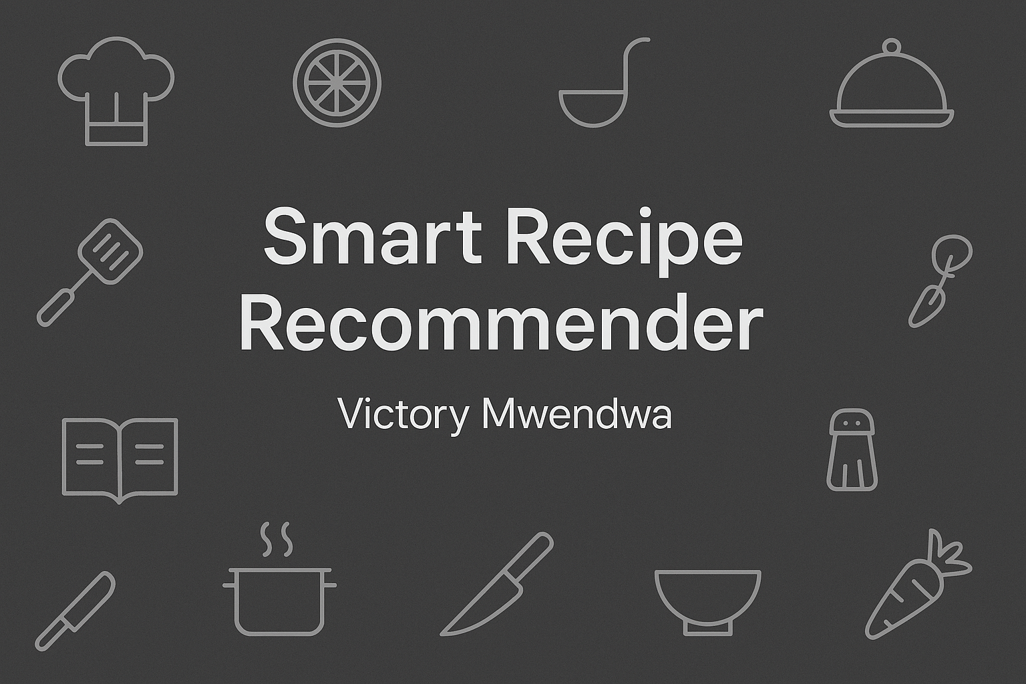
SDG-432

Slide 2

Ever stared at your pantry like it’s a puzzle and wondered, ‘What can I even make with this?!’ Finding recipes quickly based on ingredients is harder than finding Wi-Fi in the desert

Slide 3
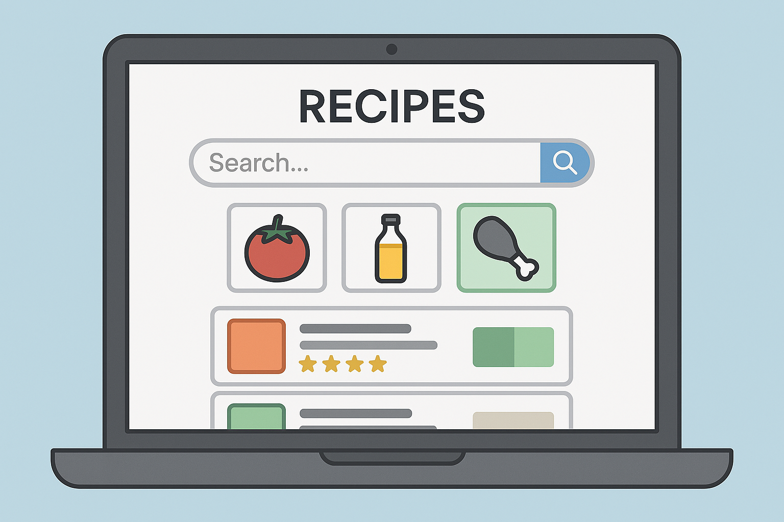
Smart Recipe Recommender allows users to search for recipes, filter by ingredients or categories, and view detailed cooking instructions.

Slide 4
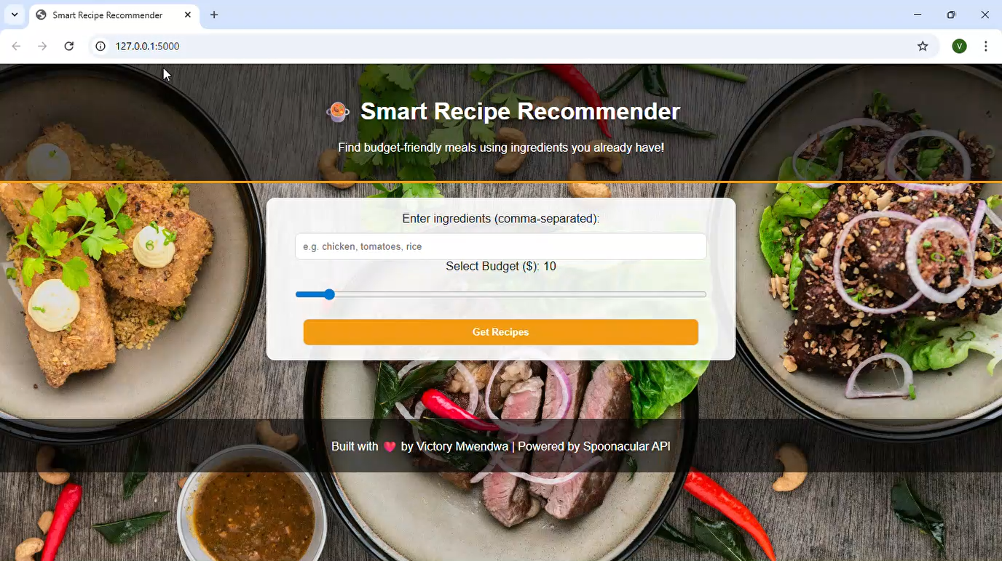
Watch my 58-second demo to see the app in action!

Slide 5
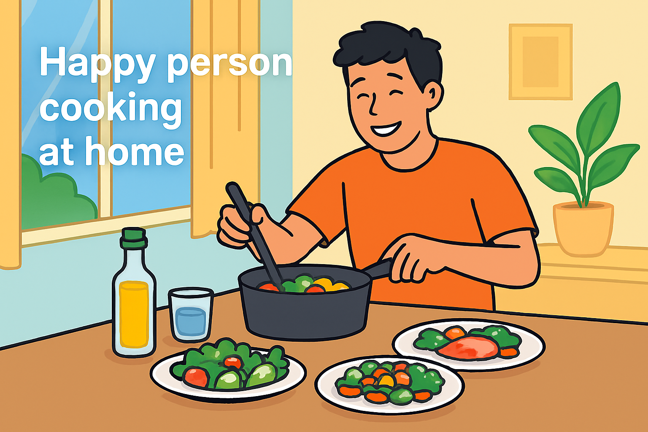
Saves time, inspires healthy cooking, and simplifies meal planning. Thank you for reviewing our project!

